Slide 2
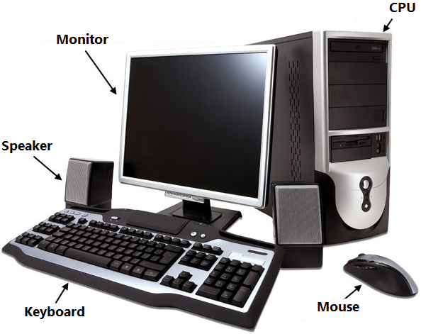
A Computer System

Slide 3
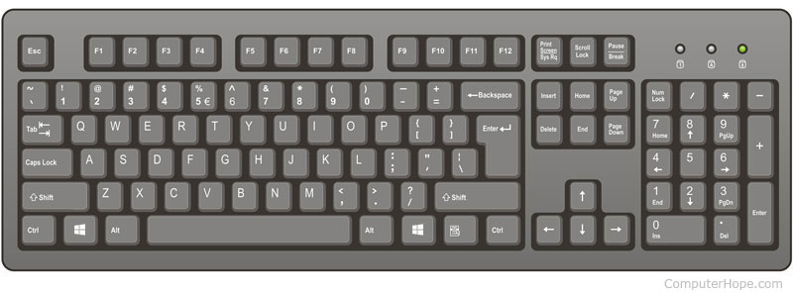
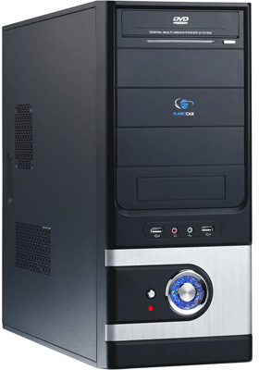
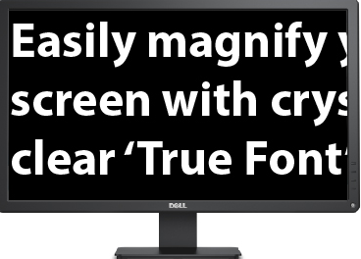
IPO Process
Input
Process
Output

Slide 4
Hardware and Software
Hardware | Software
The physical parts of a computer that you can see and touch are called hardware. | Software is a set of instructions that is also called a computer program.
Example: mouse, printer, CD | Example: OpenOffice Writer, Tux Paint, Microsoft Windows

Slide 5
Input, Output and Storage Devices
Input | Output | Storage
Devices that are used to give input i.e. instructions to the computer | Devices that are used to receive the output from the computer | Devices that are used to store the output from the computer
Example: mouse, joystick, scanner, keyboard, and web camera | Example: monitor, printer, speaker, and headphones | Example: CD, hard disk, and pen drive

Slide 6
Software
Software is a set of instructions. It is also called a computer program.
It instructs a computer hardware what to do and how to perform a particular task. It is responsible for making the hardware work.

Slide 7
Software
You cannot touch or feel software. You can only see it. For example, you can draw in Tux Paint using a mouse. Therefore, Tux Paint is a software.
There are two types of software-application software and system software.

Slide 8
Application Software
It helps you to perform specific tasks on a computer. For example, ‘Tux Paint’ helps you to draw and colour on a computer.
There are different types of application software that help us perform different tasks.

Slide 9

Application Software
Word processing applications:
Help us to create documents such as letters, labels, bills, etc.
Examples:
OpenOffice Writer
MS Word

Slide 10

Application Software
Spreadsheet applications:
- Help us to organise, store and analyse data in a tabular form.
Examples:
LibreOffice Calc
MS Excel

Slide 11

Application Software
Presentation applications:
Help us to present information in the form of a slide show.
Examples:
OpenOffice Impress
MS PowerPoint

Slide 12

Application Software
Graphics and animation applications:
Help us to create images and animate them.
Examples:
Scratch
GIMP

Slide 13

Application Software
Gaming applications:
It is used to play games.
Examples:

Slide 14
System Software
It is software that controls and manages the overall activities of a computer system.
An operating system (OS) is a set of computer programs that acts as an interface between the user of a computer and the computer hardware.

Slide 15
System Software
It allows the user to communicate with the hardware.
It is the first software to be installed on a computer. A computer cannot work without an operating system. For example: Microsoft Windows, Macintosh, Linux, Ubuntu

Slide 16
Windows 7
The Windows 7 desktop is the main screen of the Windows operating system.
There are various components of the Windows 7 screen.

Slide 17
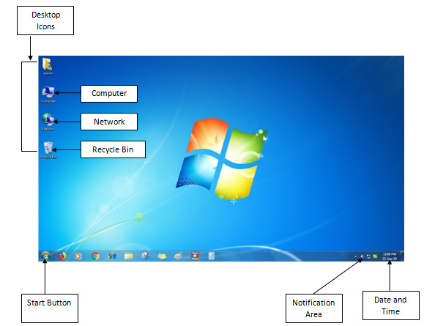
Windows 7

Slide 18


Windows 7
Desktop icons: These are small pictures or graphics on a desktop that represent an application or a program.
Commonly used icons on a desktop
Recycle bin
Network
Computer

Slide 19
Windows 7
Computer icon: Shows the list of different locations on the computer and the files stored in these locations.
Network: Shows whether the computer is connected to a network.
Recycle bin: Stores files that the user has removed or deleted from the computer.

Slide 20
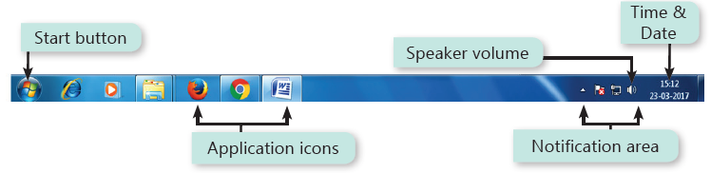
Windows 7
Taskbar: It is the long horizontal bar at the bottom of the desktop. It contains the Start button and application icons on the left, and has a notification area and icons for time, date and speaker volume on the right.

Slide 21



Windows 7
Start button: Displays the Start menu that allows the user to open different applications.
Date and time: Shows the current date and time set for the computer.
Notification area: Shows small icons that informs the user about the status of various tasks running on the computer.

Slide 22
Taking care of a computer
It is important to take care of a computer.
You must handle the computer and its parts carefully and gently to avoid damage.
You can follow some tips so that the hardware will remain in good condition for a longer time.

Slide 23
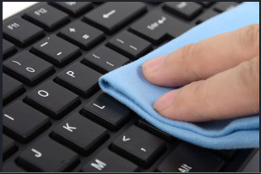
Taking care of a computer
Fight dust:
Dust is a major enemy of a computer. It causes heating up of hardware that can cause failure or problem when starting a computer.
To avoid this, clean your computer gently with a dry soft cloth, regularly. Cover your computer when it is not being used to keep it dust free.

Slide 24
Taking care of a computer
Use clean hands:
Make sure your hands are clean and dry before you type on a keyboard or click a mouse.
Dirty or wet hands can result in sticky keys on a keyboard and cause stains on the display screen.

Slide 25

Taking care of a computer
No food or drinks:
Do not keep food or drinks near your computer, as it can spill on it accidently. This can damage the hardware, and it may not work as expected.

Slide 26
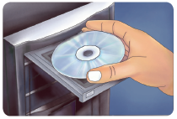
Taking care of a computer
Handle with care:
The way you handle your hardware devices will determine how long they will last.
Always hold the CD correctly by holding it at its edges.
Press the keys of the keyboard softly and handle the mouse gently.

